Slide 1
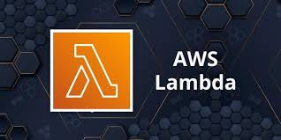
Technical Presentation on
By
Lalit Patil Moha Nalawade Mukesh Yadav Naveesh Kardam | 243526 243527 243528 243529

Slide 2
What is AWS Lambda?
AWS Lambda is a compute service that lets you run code without provisioning or managing servers.
AWS Lambda executes your code only when needed and scales automatically, from a few requests per day to thousands per second.
The code is executed based on the response of events in AWS services such as adding/removing files in S3 bucket, updating Amazon dynamo dB tables, HTTP request from Amazon API gateway etc.
You pay only for the compute time you consume - there is no charge when your code is not running.

Slide 3
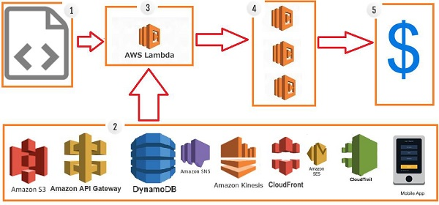
How AWS Lambda Works?
Step 1 − Upload AWS lambda code in any of languages AWS lambda supports
Step 2 − These are few AWS services on which AWS lambda can be triggered.
Step 3 − AWS Lambda which has the upload code and the event details on which the trigger has occurred.
Step 4 − Executes AWS Lambda Code only when triggered by AWS services under the scenarios such as −User uploads files in S3 bucket
Step 5 − Remember that AWS charges only when the AWS lambda code executes, and not otherwise.

Slide 4
Pricing of AWS (Amazon Web Services) Lambda Function
AWS lambda pricing is based on the no.of requests made to your function and the time it has taken to execute the function.
The following are the pricing factors to be considered for AWS Lambda.
As previously mentioned, with AWS Lambda user only pays for what he uses, factoring in the number of requests and duration of the execution of the code.
No charges are taken for creating lambda functions.

Slide 5
Pricing of AWS (Amazon Web Services) Lambda Function
Lambda considers a request to be each time it starts executing in response to a trigger such as an event notification or an invocation volume.
The duration of the code is calculated from the moment the code begins executing until it returns or is terminated. If one is unsure about whether AWS Lambda is the right choice or not, there is a free tier option available to try. This option includes 1M free requests per month and 400,000 GB-seconds of compute time per month.

Slide 6
What Triggers AWS Lambda Functions?
Many event sources can trigger Lambda functions (cause Lambda to run your code).
For Example :
You can trigger a Lambda function by updating tables in Amazon DynamoDB,
AWS IoT
Streaming data through serverless processing with Amazon Kinesis.
CloudFront
Changing an object in Amazon S3
Alexa Smart home Appliance

Slide 7
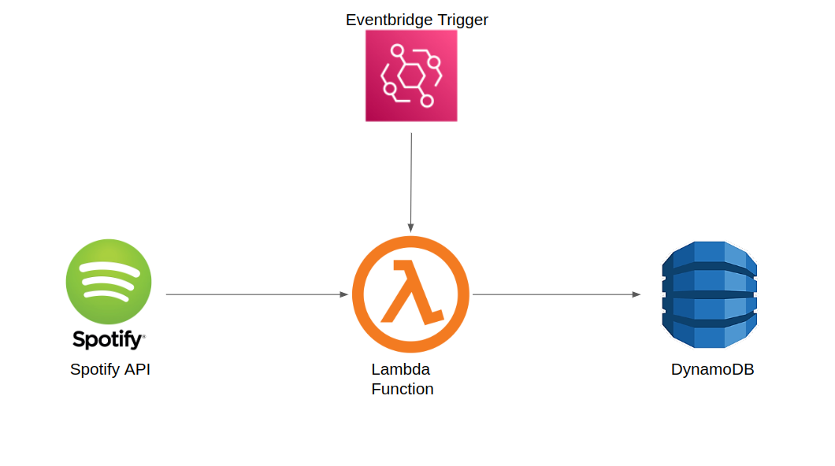
Trigger for updating tables in Amazon DynamoDB
https://www.analyticsvidhya.com/blog/2023/01/aws-lambda-tutorial-creating-your-first-lambda-function/

Slide 8
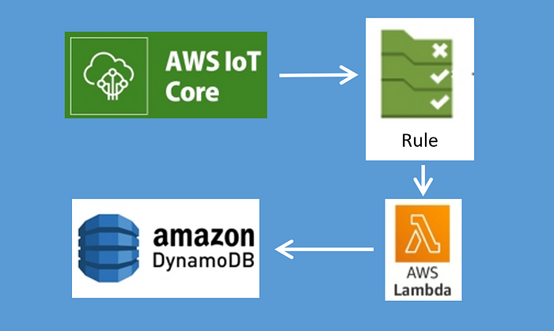
Trigger with AWS IOT
https://medium.com/@md.tarikulislamjuel/aws-iot-core-rule-lambda-dynamodb-8f6dd993bc3f

Slide 9
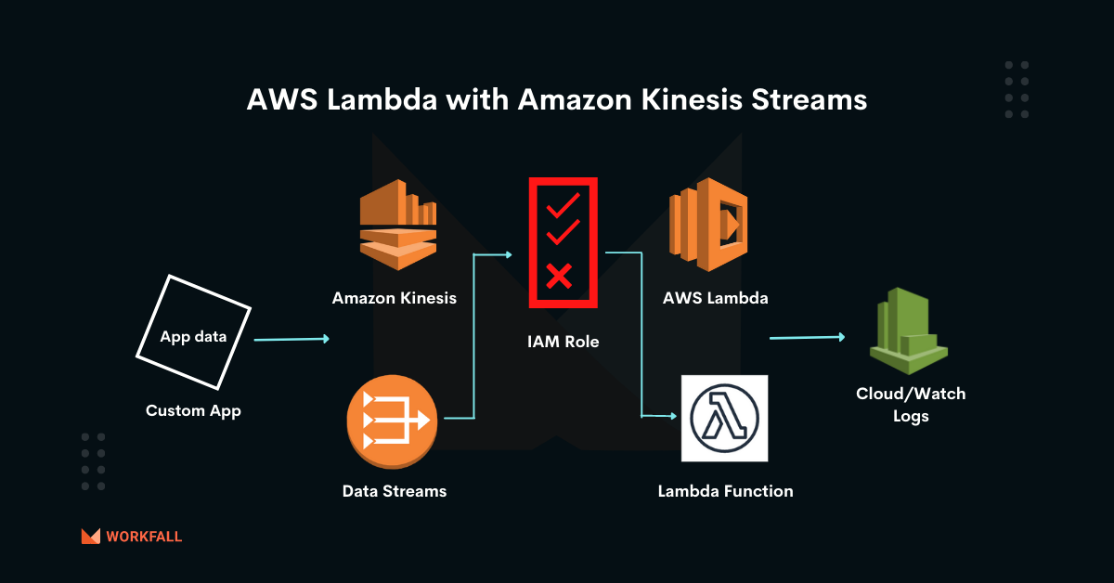
Trigger with Amazon Kenisis
https://www.workfall.com/learning/blog/how-to-do-event-driven-programming-using-aws-lambda-with-amazon-kinesis-streams/

Slide 10
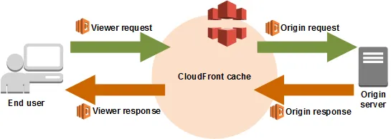
Trigger CloudFront
https://docs.aws.amazon.com/lambda/latest/dg/lambda-edge.html

Slide 11
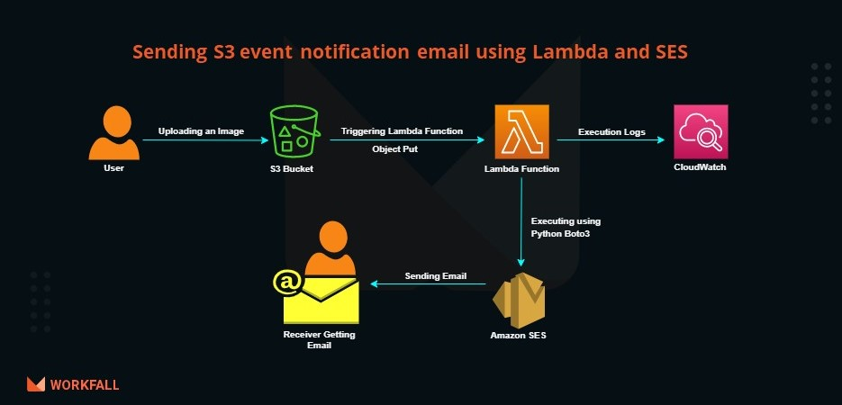
Trigger for Transforming S3 bucket object
https://www.workfall.com/learning/blog/send-s3-event-notification-email-using-lambda-and-ses/

Slide 12
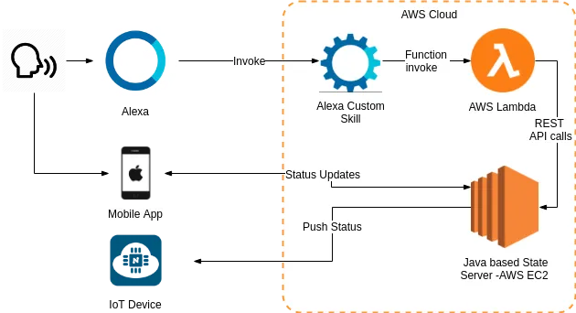
Alexa Smart Home Appliance
https://medium.com/coinmonks/alexa-custom-skill-with-aws-lambda-to-control-iot-device-68f37beac3fb

Slide 13
AWS Lambda Vs. EC2: How They Compare
Lambda is a fully managed serverless computing service where you only need to upload and run your code to start.
EC2 contrasts that by using cloud-based virtual machines (VMs) architecture. So EC2 will let you control or customize instances, provision capacity, operating system, network tools, and tweak the underlying infrastructure to improve aspects such as security.
But that is if you have experience handling those responsibilities.
With EC2, you can migrate existing applications to the cloud more rapidly because you do not have to change their architecture too much. You can instead change the EC2 infrastructure to support the app.
But if you do not have the experience, budget, and time to swim in a pool of technical responsibilities, Lambda provides a managed, readily available, highly scalable, and assuringly secure serverless computing platform.
You won’t have access to its infrastructure because AWS handles everything on your behalf.
Lambda also only runs in response to a trigger known as an event. It does not run 24/7, unlike other Platform-as-a-Service (PaaS) offerings. That makes it more cost-effective because AWS charges you for only the resources you use.

Slide 14
Compute Options | AWS EC2 | AWS Lambda
Type of Compute | Instance; Infrastructure as a Service (IaaS) | Function; Function as a Service (FaaS)
Defining Features | Extensive instance configuration | Serverless function deployment
Use Cases | General computing; complete control over instance | Smaller applications that run in less than 15 minutes
Availability | SLA: 99.99% | SLA: 99.95%
Scalability | Combines with Auto Scaling Group to scale out/in as defined in ASG policies | AWS Lambda automatically scales on your behalf
Service endpoint | IPv4, IPv6 | Interface VPC endpoints
Encryption | Supports encrypted EBS volume | Uses HTTPS for encryption in transit; Uses AWS KMS for encryption at rest
Timeout | N/A | 300 seconds (15 minutes)
Pricing | Varies by instance type, time run, and launch type (spot instances, RI, scheduled, etc.) | Number of requests and time it takes for code to execute
PG- DBDA IACSD Akurdi

Slide 15
Advantages of using AWS Lambda
Ease of working with code-AWS Lambda gives you the infrastructure to upload your code. It takes care of maintaining the code and triggers the code whenever the required event happens. It allows you to choose the memory and the timeout required for the code.
AWS Lambda can also execute parallel requests as per the event triggers.
Log Provision-AWS Lambda gives the details of number of times a code was executed and time taken for execution, the memory consumed etc. AWS CloudWatch collects all the logs, which helps in understanding the execution flow and in the debugging of the code.

Slide 16
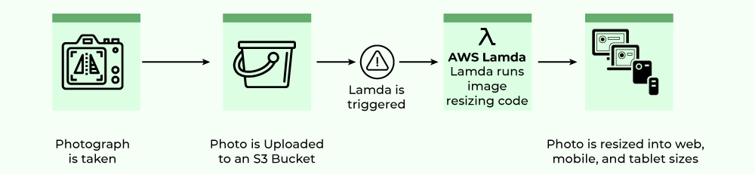
Common Lambda application types and use cases
File processing – Suppose you have a photo sharing application. People use your application to upload photos, and the application stores these user photos in an Amazon S3 bucket. Then, your application creates a thumbnail version of each user's photos and displays them on the user's profile page. In this scenario, you may choose to create a Lambda function that creates a thumbnail automatically. Amazon S3 is one of the supported AWS event sources that can publish object-created events and invoke your Lambda function. Your Lambda function code can read the photo object from the S3 bucket, create a thumbnail version, and then save it in another S3 bucket.

Slide 17
Common Lambda application types and use cases
Data and analytics – Suppose you are building an analytics application and storing raw data in a DynamoDB table. When you write, update, or delete items in a table, DynamoDB streams can publish item update events to a stream associated with the table. In this case, the event data provides the item key, event name (such as insert, update, and delete), and other relevant details. You can write a Lambda function to generate custom metrics by aggregating raw data.

Slide 18
Common Lambda application types and use cases
Websites – Suppose you are creating a website and you want to host the backend logic on Lambda. You can invoke your Lambda function over HTTP using Amazon API Gateway as the HTTP endpoint. Now, your web client can invoke the API, and then API Gateway can route the request to Lambda.
Mobile applications – Suppose you have a custom mobile application that produces events. You can create a Lambda function to process events published by your custom application. For example, you can configure a Lambda function to process the clicks within your custom mobile application

Slide 19
Common Lambda application types and use cases
You can use an AWS Lambda function to process records in an Amazon Kinesis data stream.
Amazon Kinesis Data Streams is a serverless streaming data service that simplifies the capture, processing, and storage of data streams at any scale. With Amazon Kinesis Video Streams, you can more easily and securely stream video from connected devices to AWS for analytics, ML, playback, and other processing.

Slide 20
Advantages of using AWSLambda
Billing based on Usage-AWS Lambda gives the details of number of times a code was executed and time taken for execution, the memory consumed etc. AWS CloudWatch collects all the logs, which helps in understanding the execution flow and in the debugging of the code.
Multi Language Support-AWS Lambda supports popular languages such as Node. js, Python, Java, C# and Go. These are widely used languages and any developer will find it easy to write code for AWS Lambda.
Ease of code authoring and deploying-There are many options available for Lambda for authoring and deploying code. For writing your code, you can use AWS online editor, Visual Studio IDE, or Eclipse IDE. It also has support for serverless framework which makes writing and deploying of AWS Lambda code easy. Besides AWS console, we have AWS-cli to create and deploy code.

Slide 21
Disadvantages of using AWS Lambda
It is not suitable for small projects.
You need to carefully analyze your code and decide the memory and timeout. Incase if your function needs more time than what is allocated, it will get terminated as per the timeout specified on it and the code will not be fully executed.
Since AWS Lambda relies completely on AWS for the infrastructure, you cannot install anything additional software if your code demands it.

Slide 22
Conclusion
AWS Lambda is a service which computes the code without any server.
It is said to be serverless compute.
The code is executed based on the response of events in AWS services such as adding/removing files in S3 bucket, updating Amazon DynamoDB tables, HTTP request from Amazon API Gateway etc.

Slide 23
References
https://docs.aws.amazon.com/lambda/latest/dg/getting-started.html
https://medium.com/@md.tarikulislamjuel/aws-iot-core-rule-lambda-dynamodb-8f6dd993bc3f
https://medium.com/@md.tarikulislamjuel/aws-iot-core-rule-lambda-dynamodb-8f6dd993bc3f
https://www.workfall.com/learning/blog/how-to-do-event-driven-programming-using-aws-lambda-with-amazon-kinesis-streams/
https://www.workfall.com/learning/blog/send-s3-event-notification-email-using-lambda-and-ses/
https://medium.com/coinmonks/alexa-custom-skill-with-aws-lambda-to-control-iot-device-68f37beac3fb
https://www.ourtutorials.in/iot/iot_levels.php#google_vignette

Slide 24
Thank you and no questions please.

Slide 25
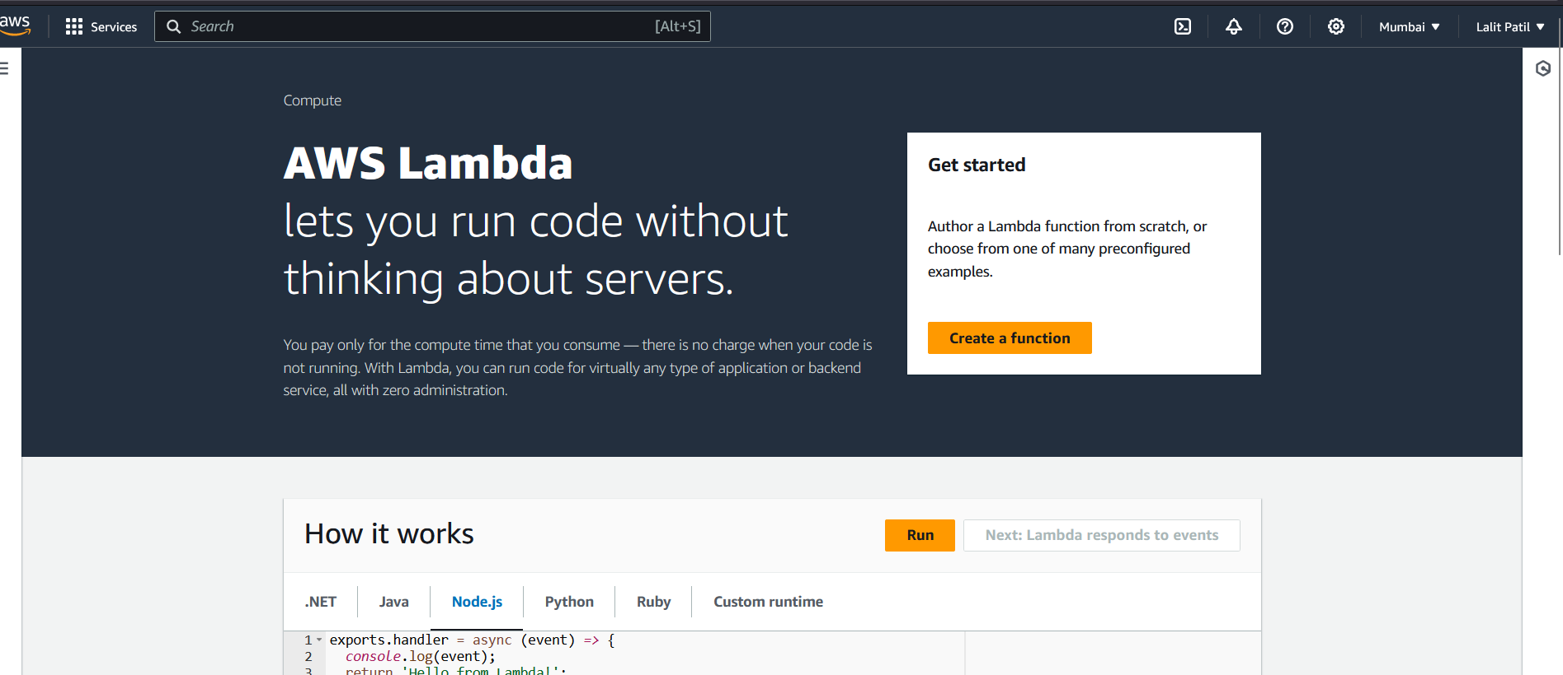
Data back up using AWS lambda- Demonstration

Slide 26
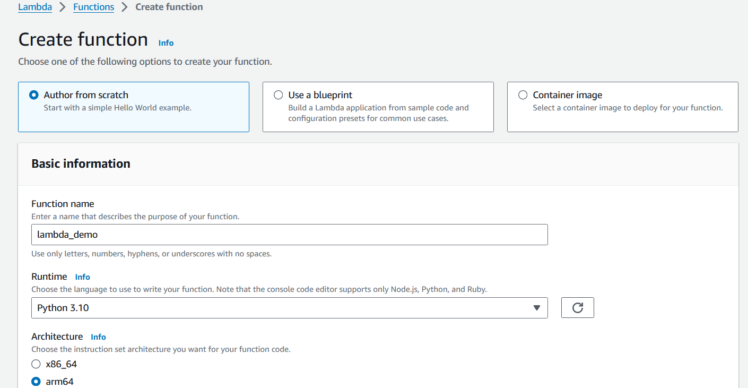
1 Create function

Slide 27
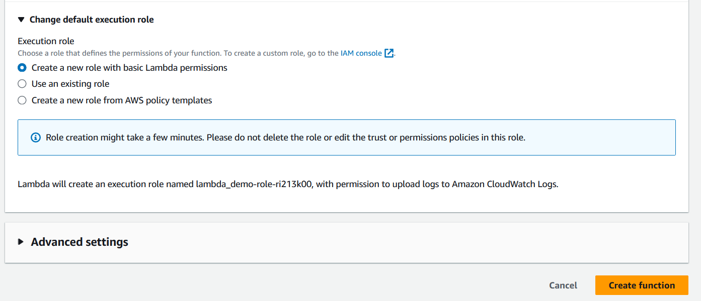
Keep all other options default, click create function

Slide 28
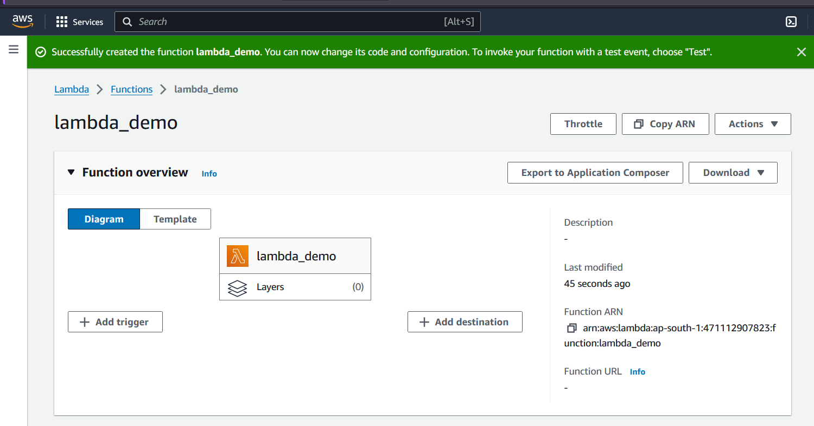
Lambda Function created

Slide 29
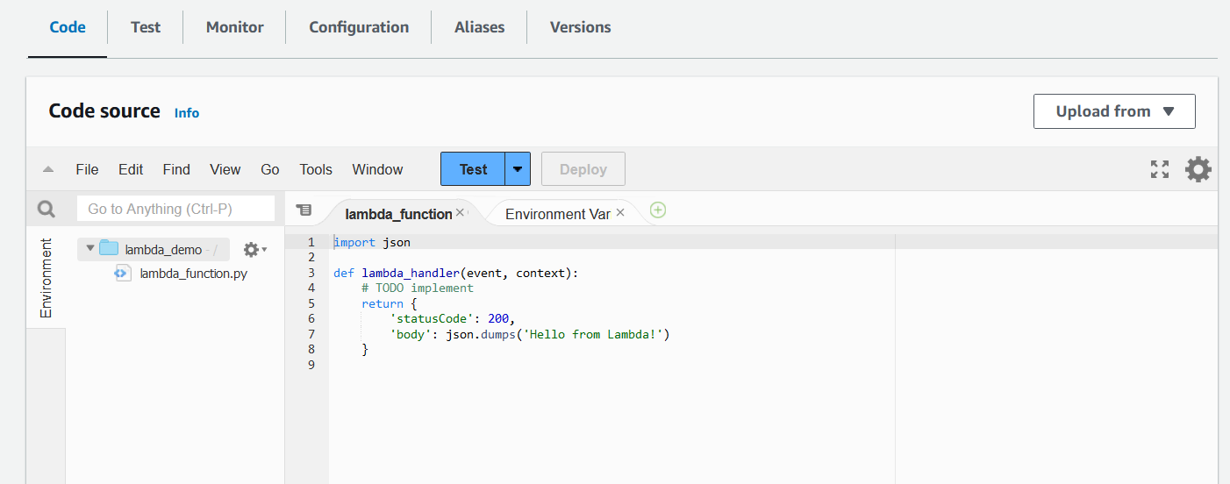
Select code tab and write a desired code.

Slide 30
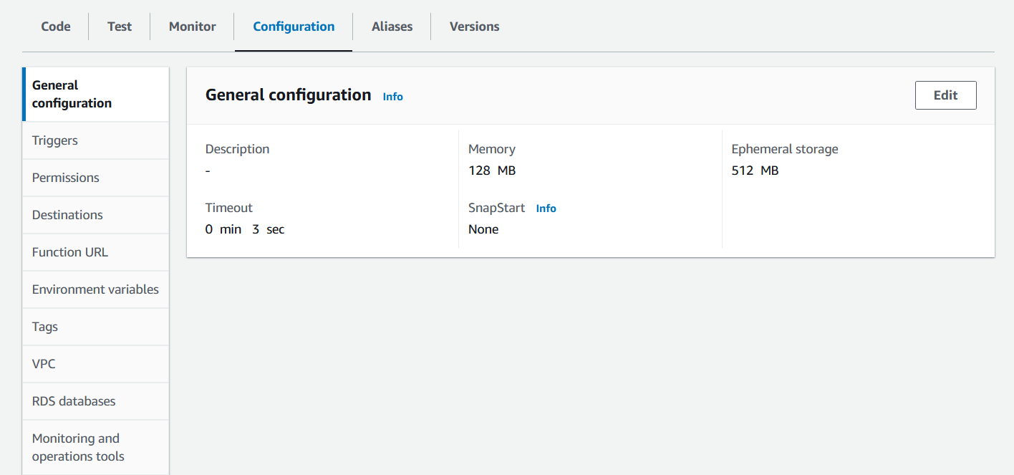
Select configuration tab.

Slide 31
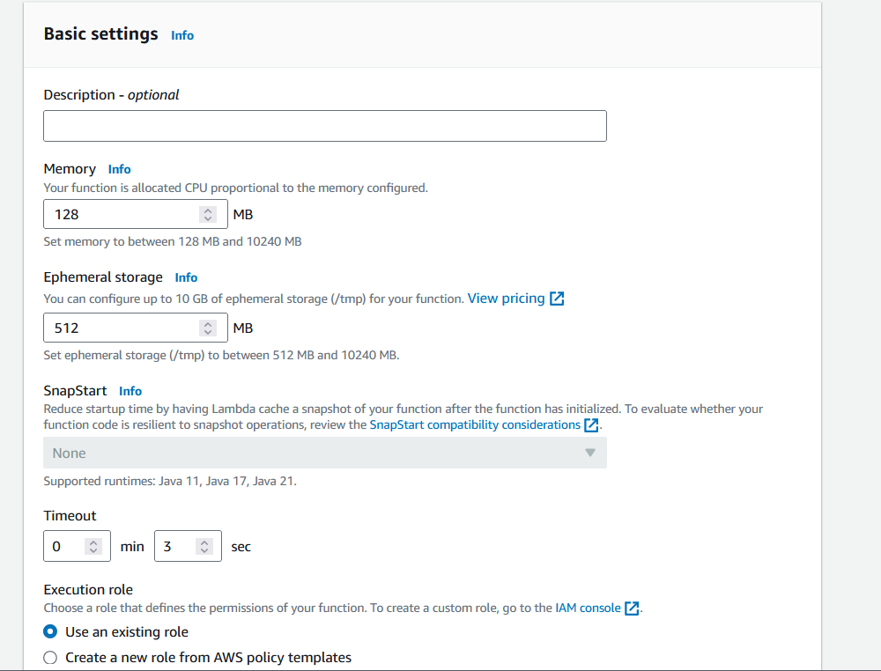
Choose sufficient time and memory for input file processing

Slide 32
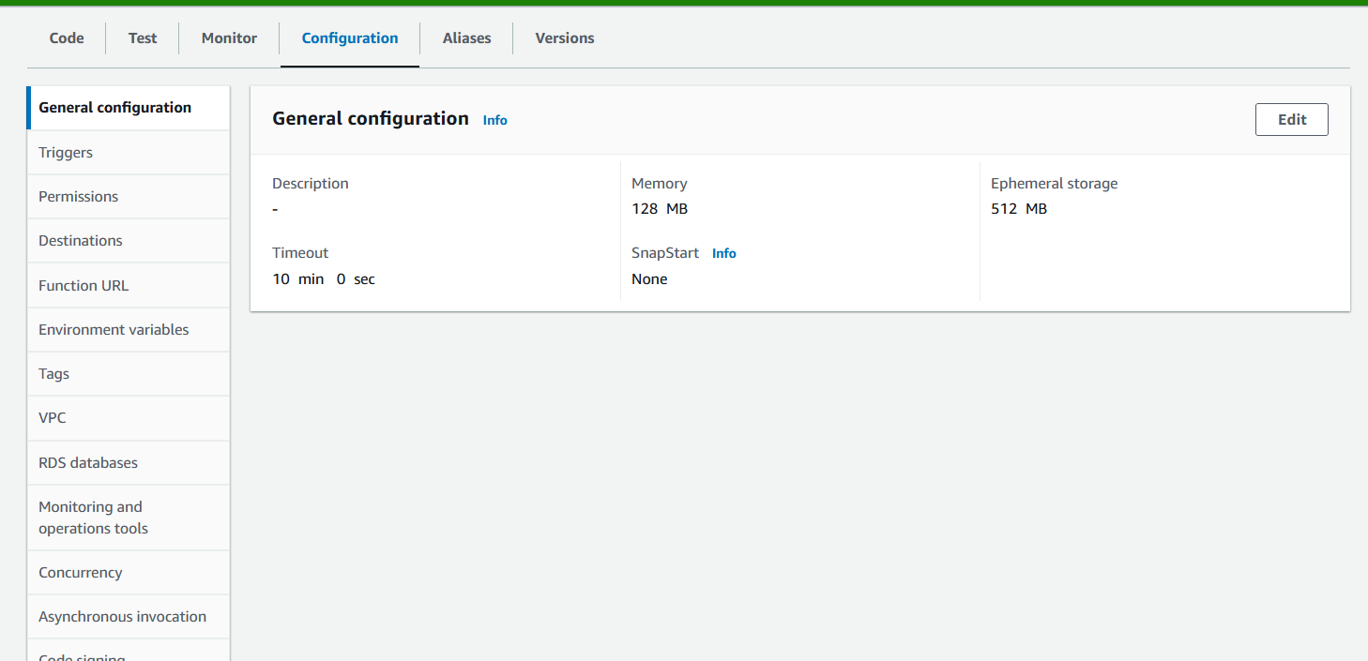
Timeout set to 10 min, max 15 minutes allowed.

Slide 33
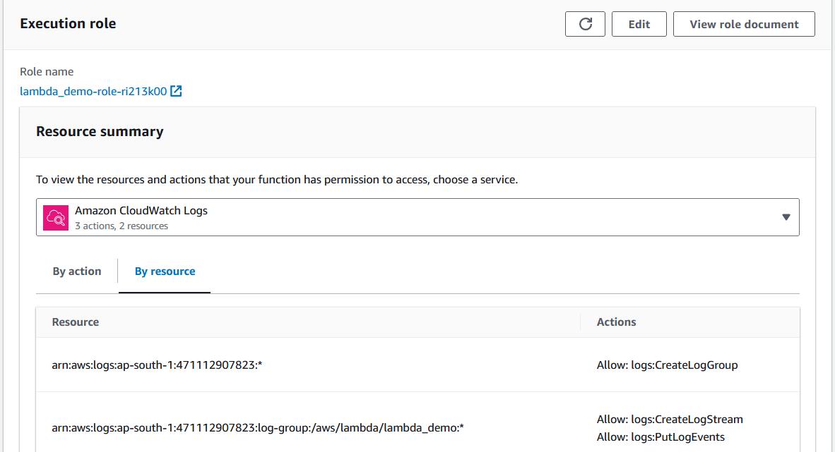
Select role and click on role name

Slide 34
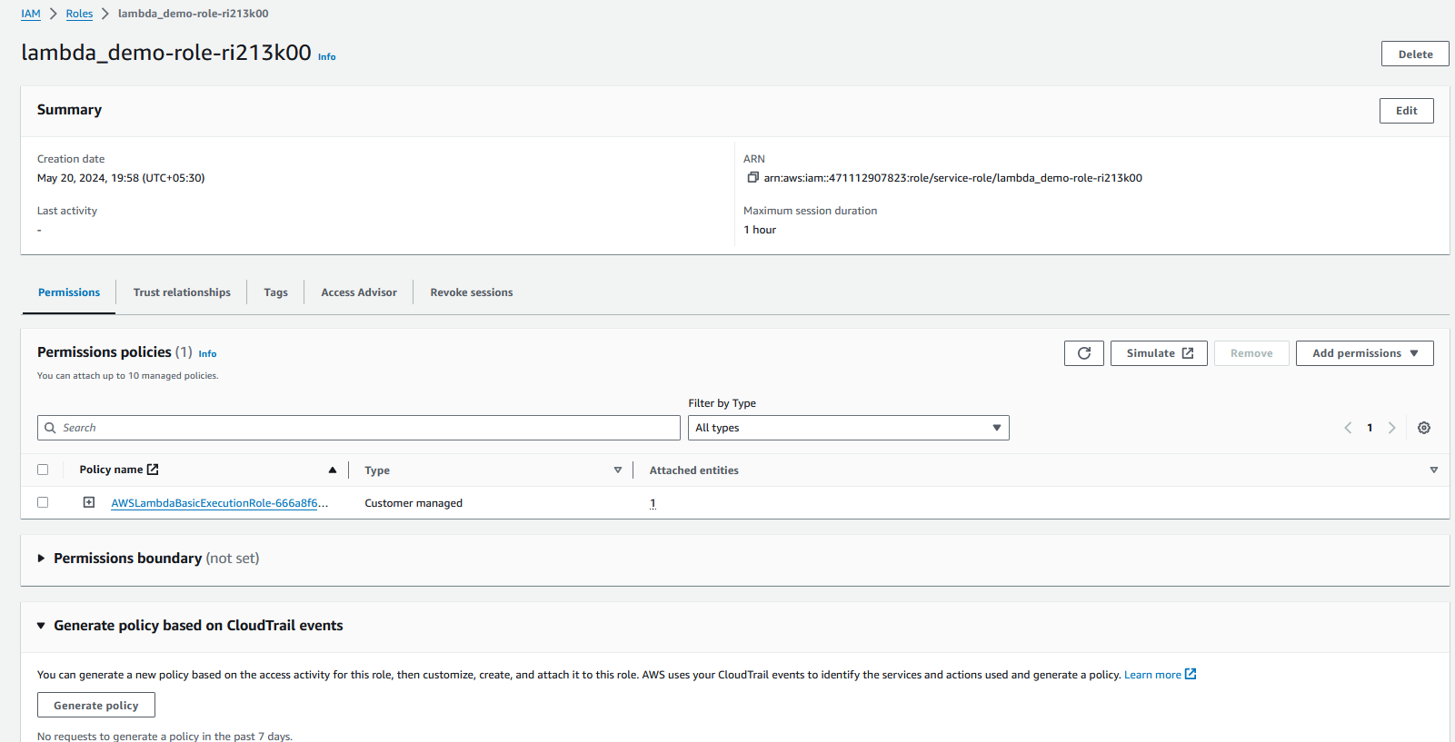
Choose add permissions

Slide 35
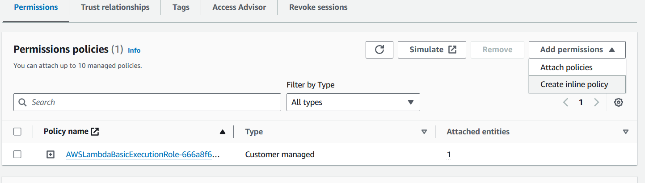
Choose create policy from drop down options.

Slide 36
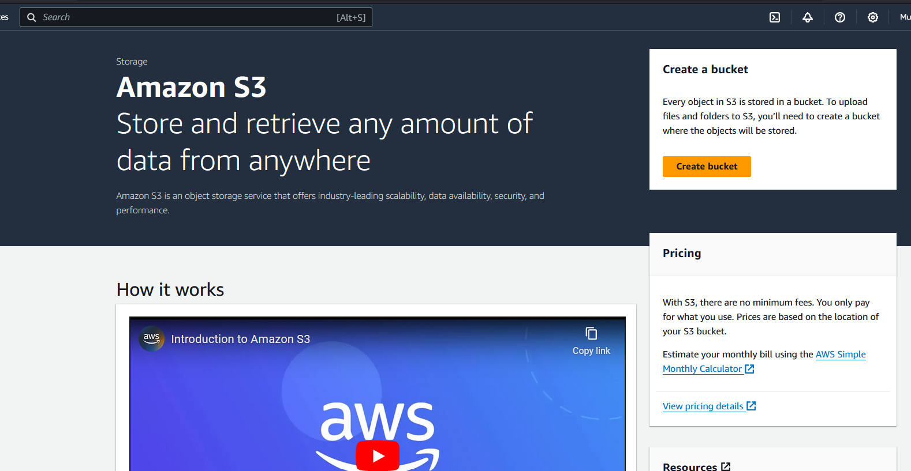
Creating S3 bucket

Slide 37
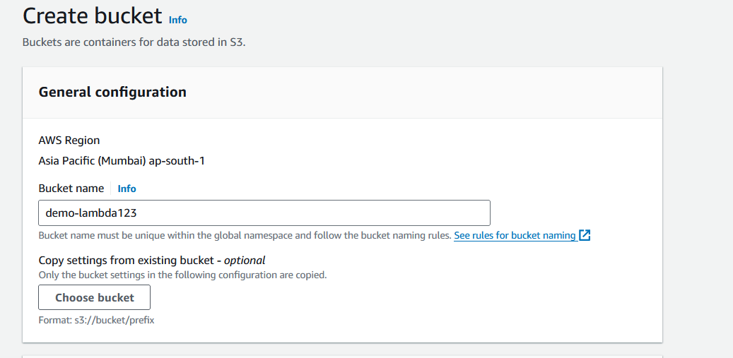
Create bucket , give relevant name

Slide 38
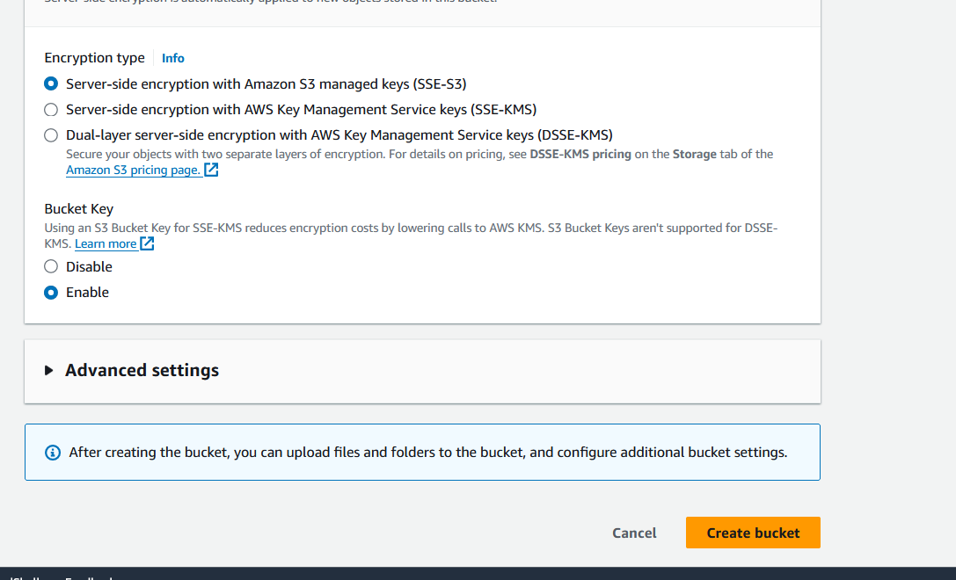
Keep other options default , select create bucket.

Slide 39
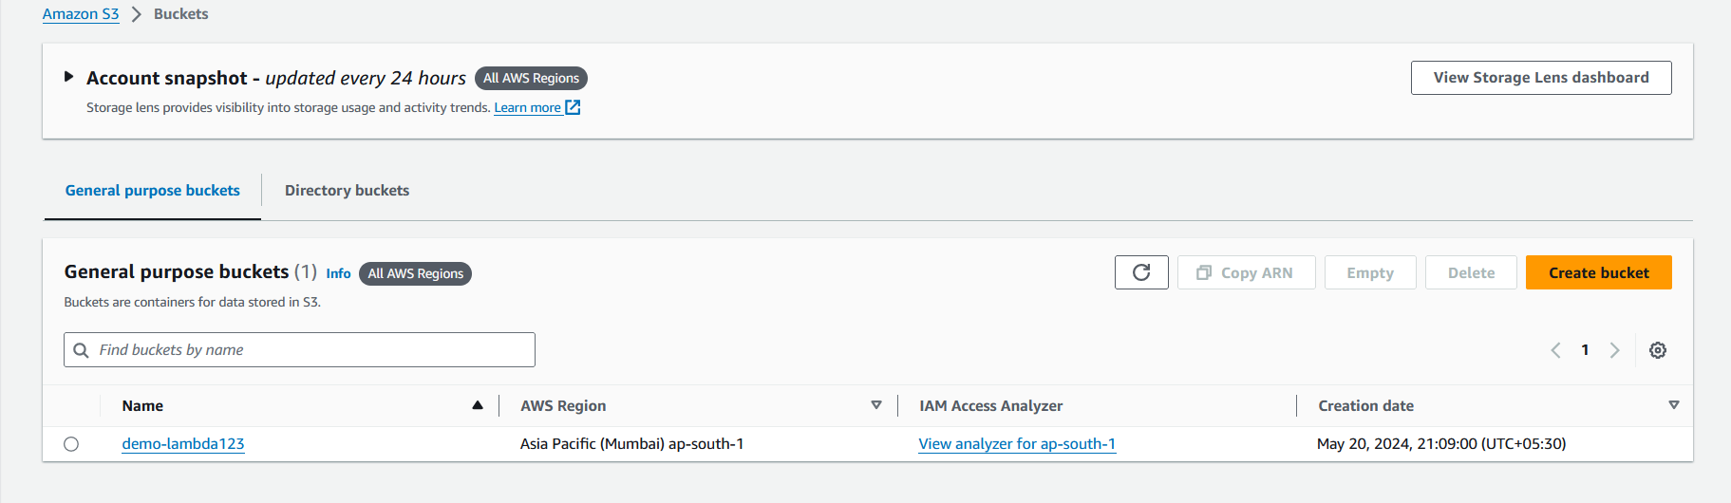

Slide 40
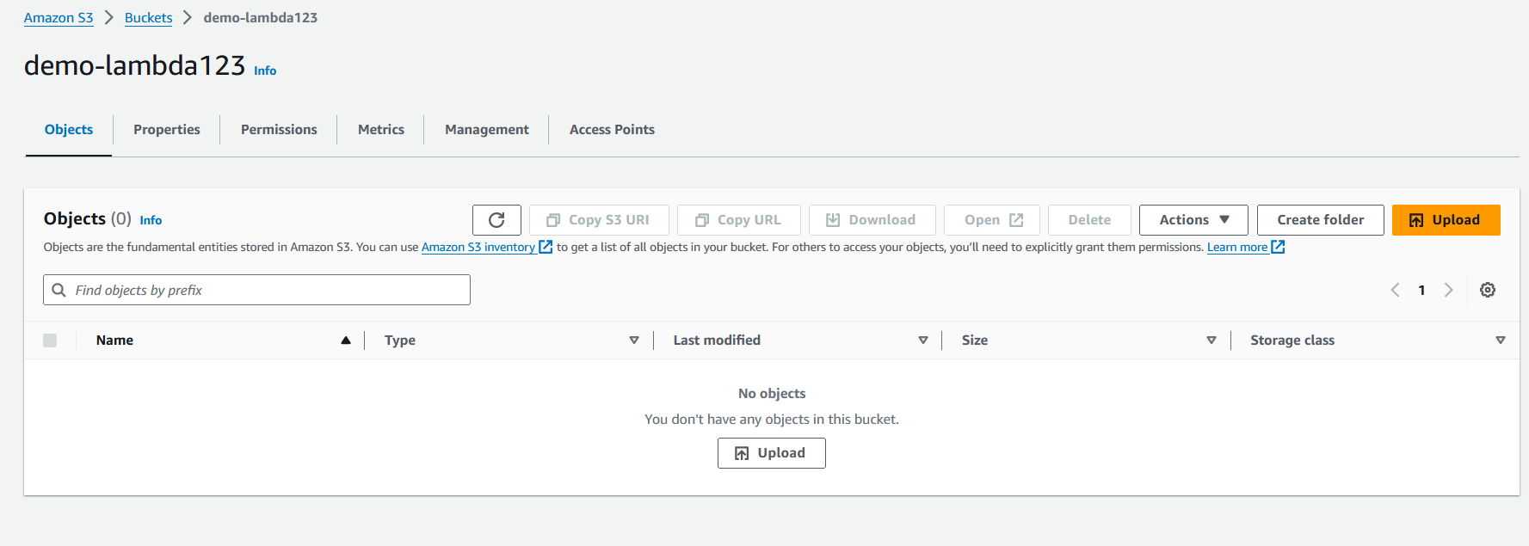
Creating input and output folder

Slide 41
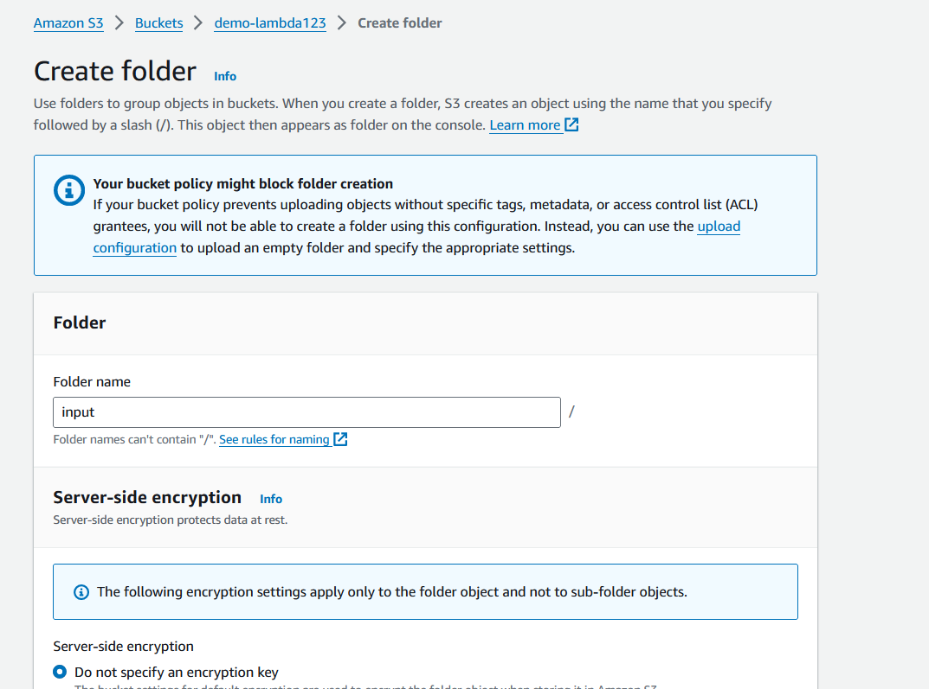

Slide 42
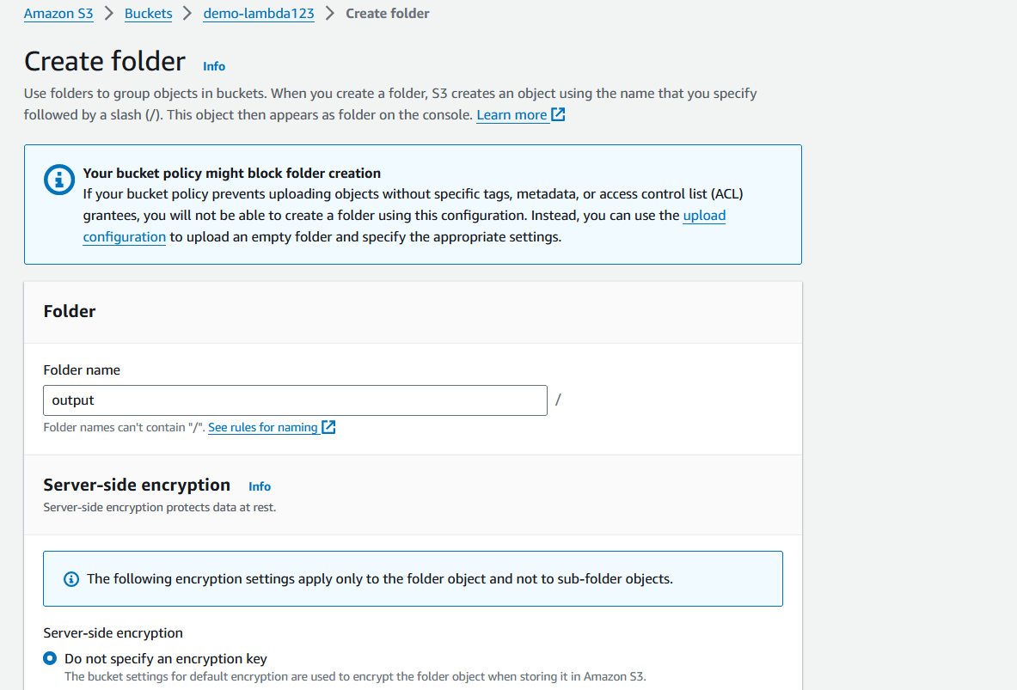

Slide 43
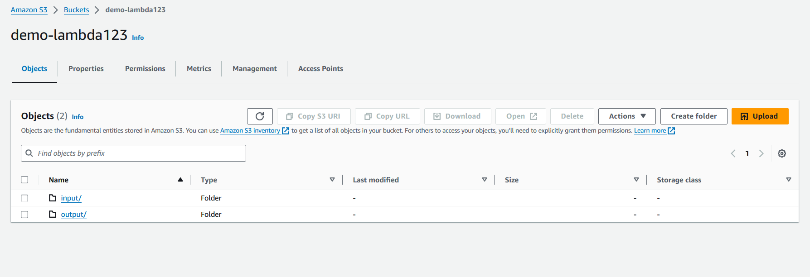
Folder created

Slide 44
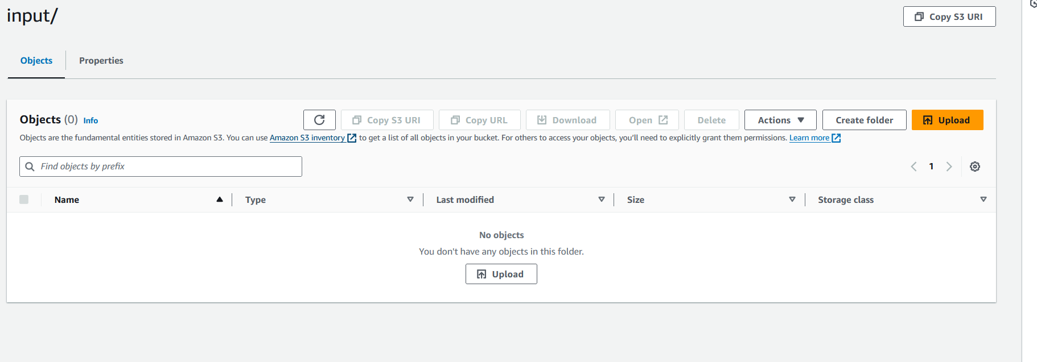
Upload input file in input folder

Slide 45
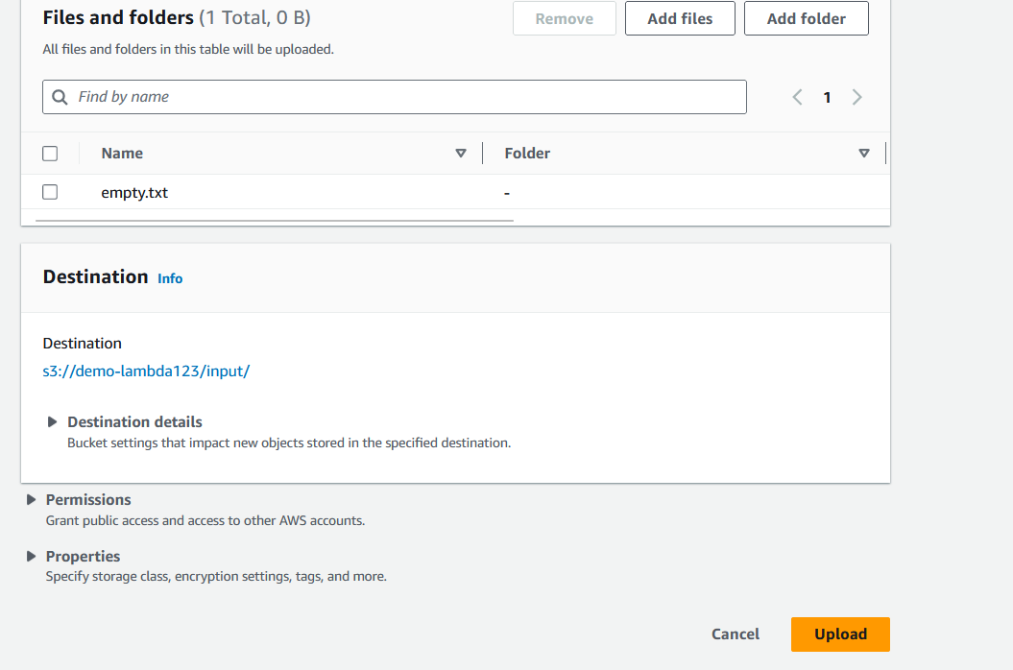

Slide 46
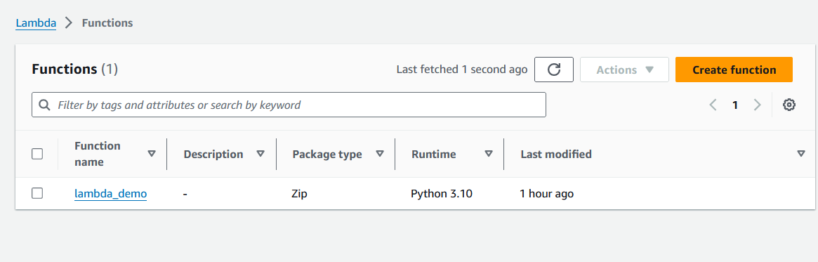
Go to lambda services

Slide 47
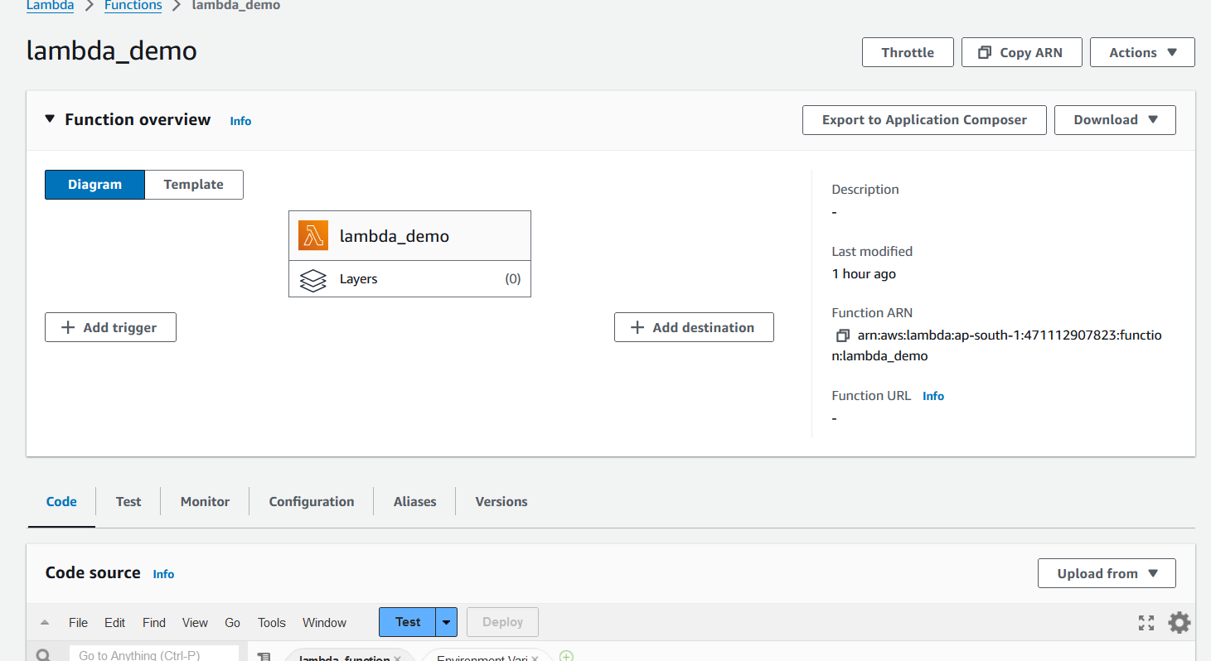
Advantages of using AWS Lambda

Slide 48
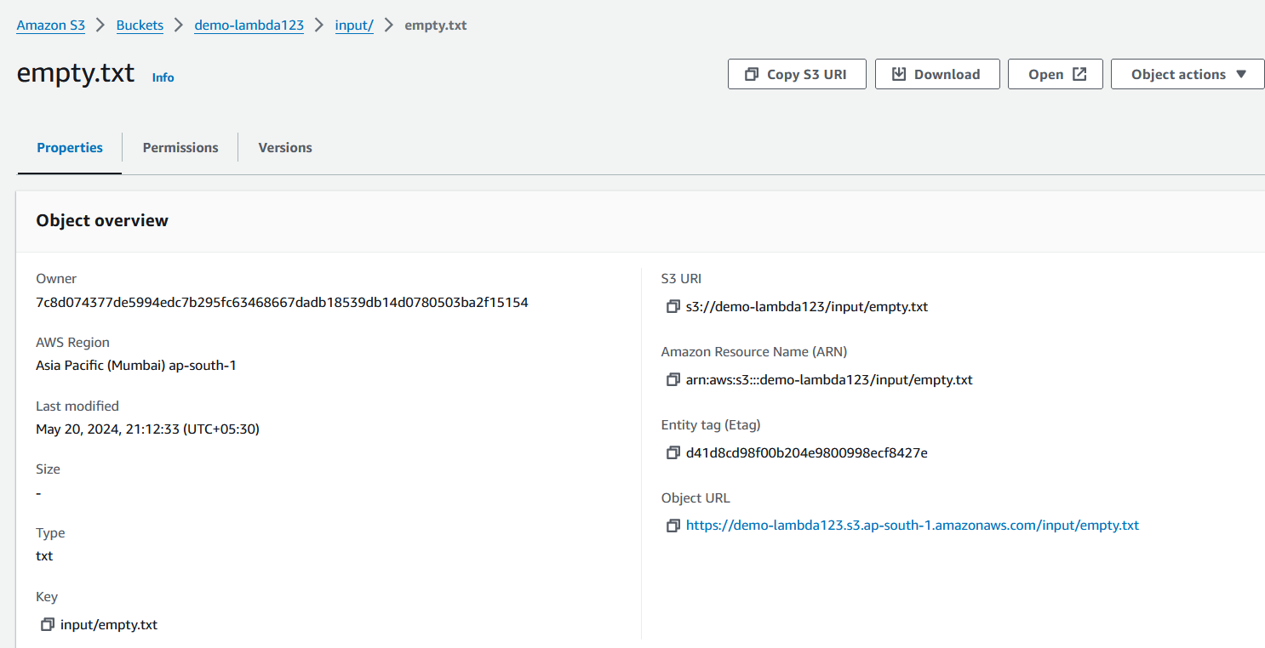
Copy key

Slide 49
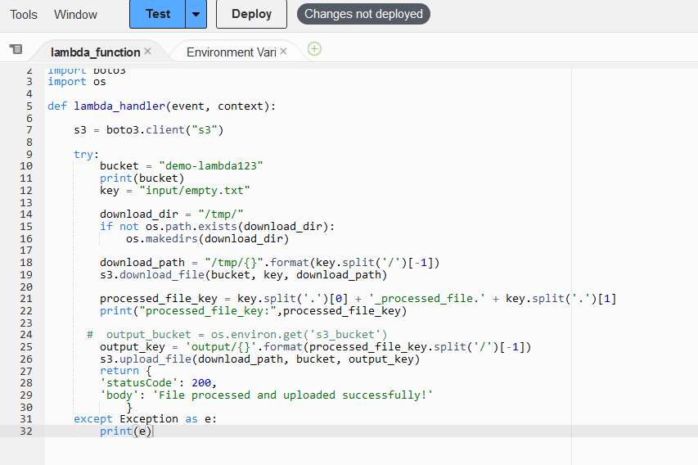
Update file name and key with path in the code

Slide 50
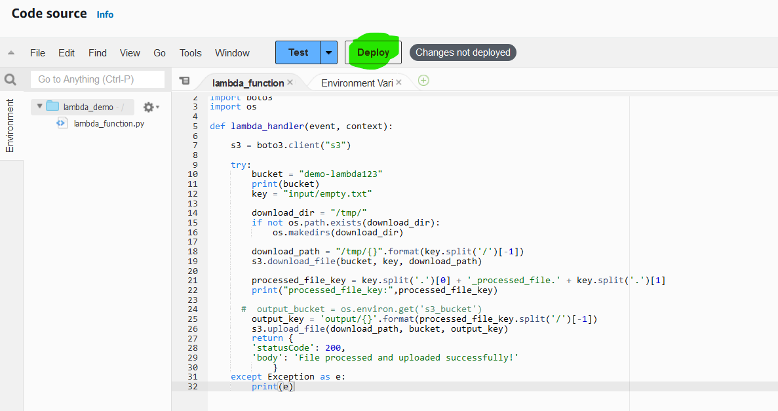
Deploy code

Slide 51
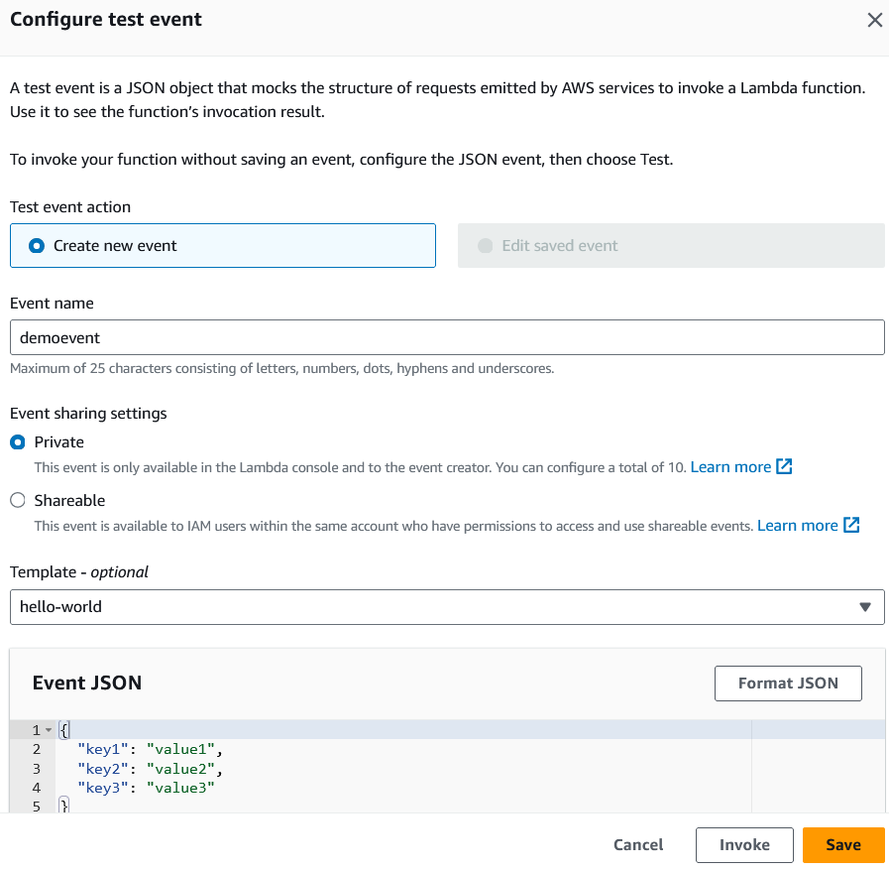
Configure test event

Slide 52
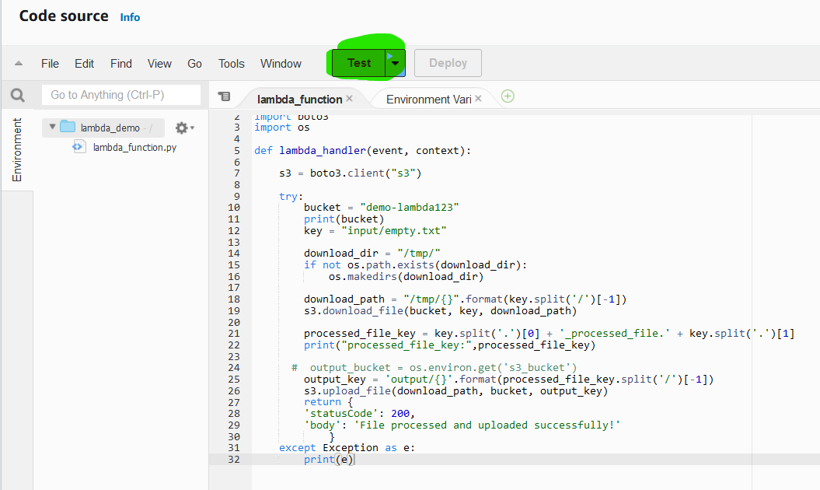
Test the code

Slide 53
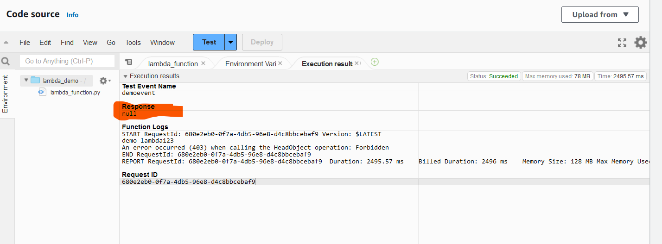
Error occurs.

Slide 54
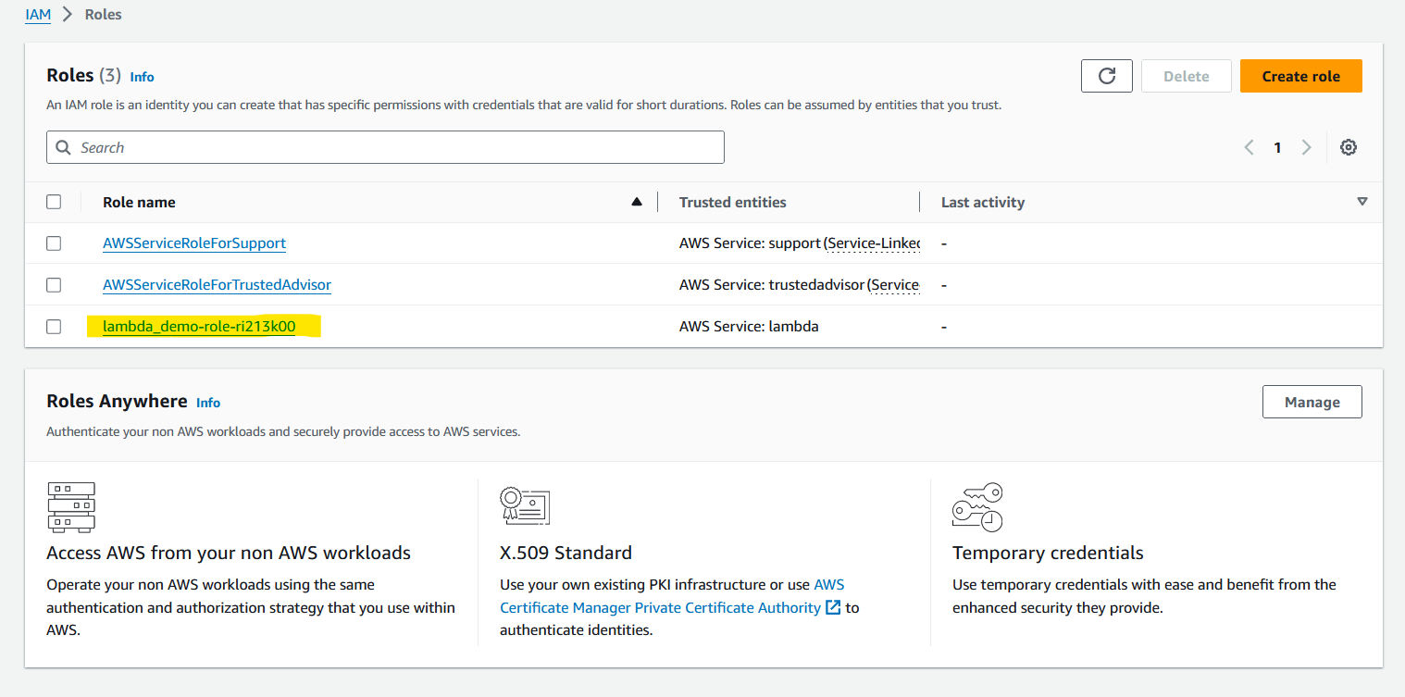
Advantages of using AWS Lambda

Slide 55
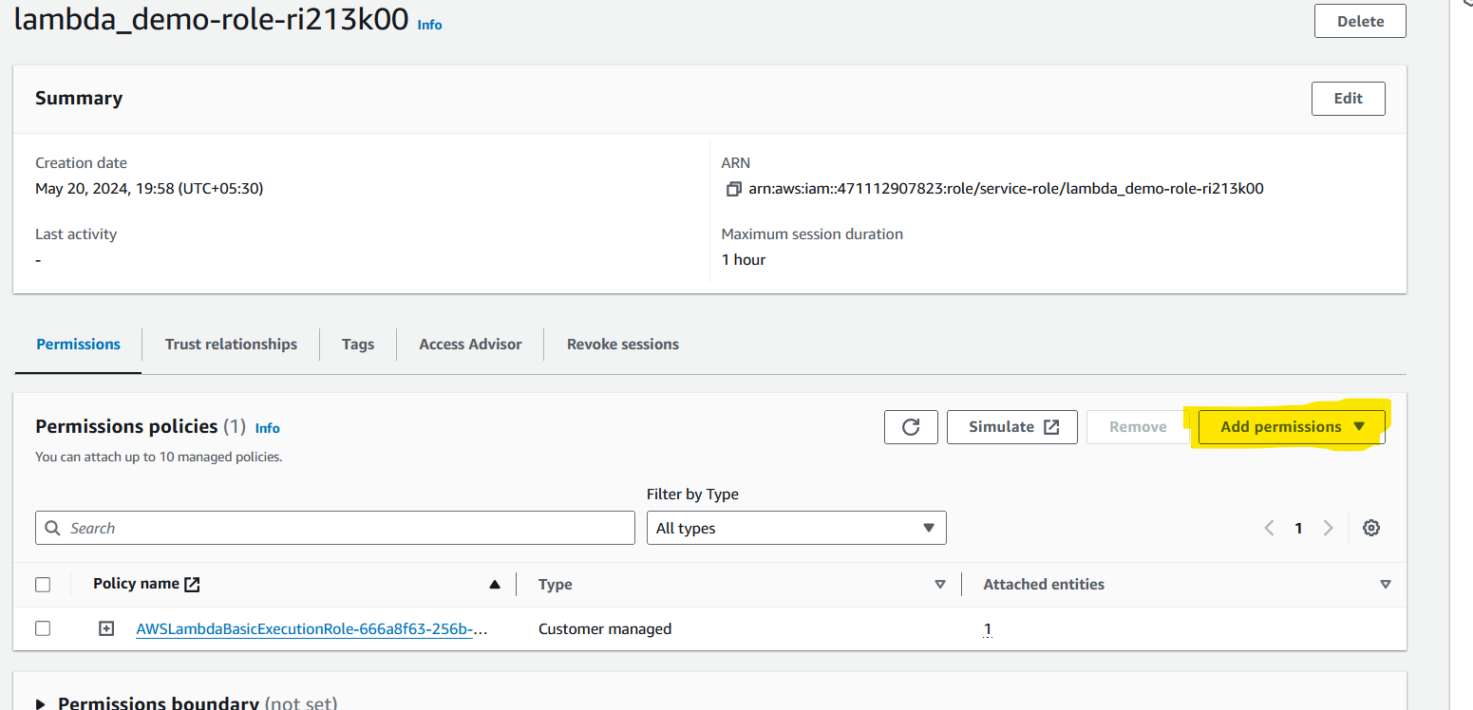
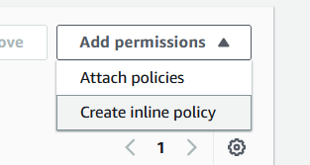
Need to set permissions

Slide 56
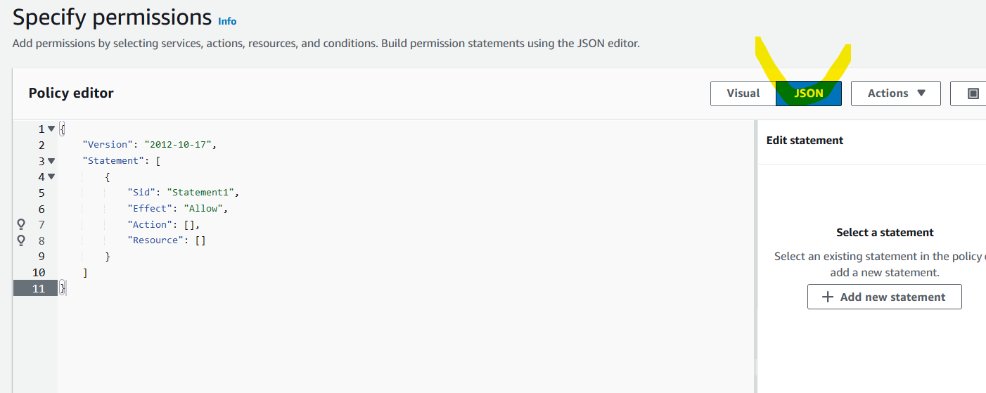
Select JSON

Slide 57
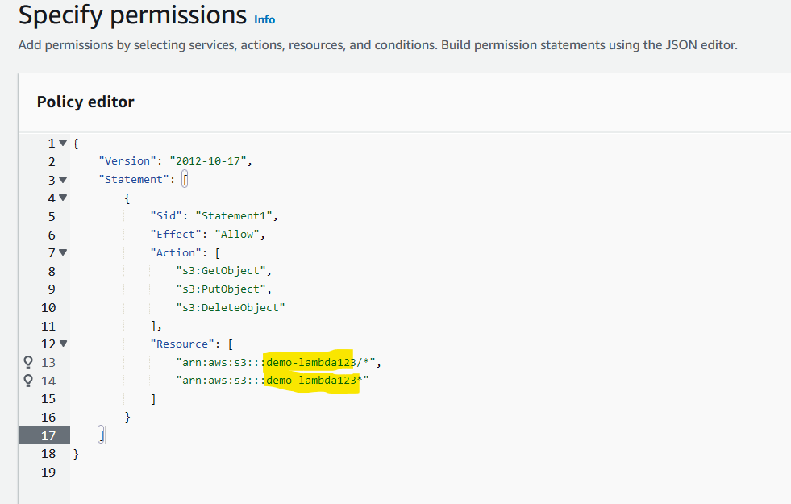
Put filename at resources

Slide 58
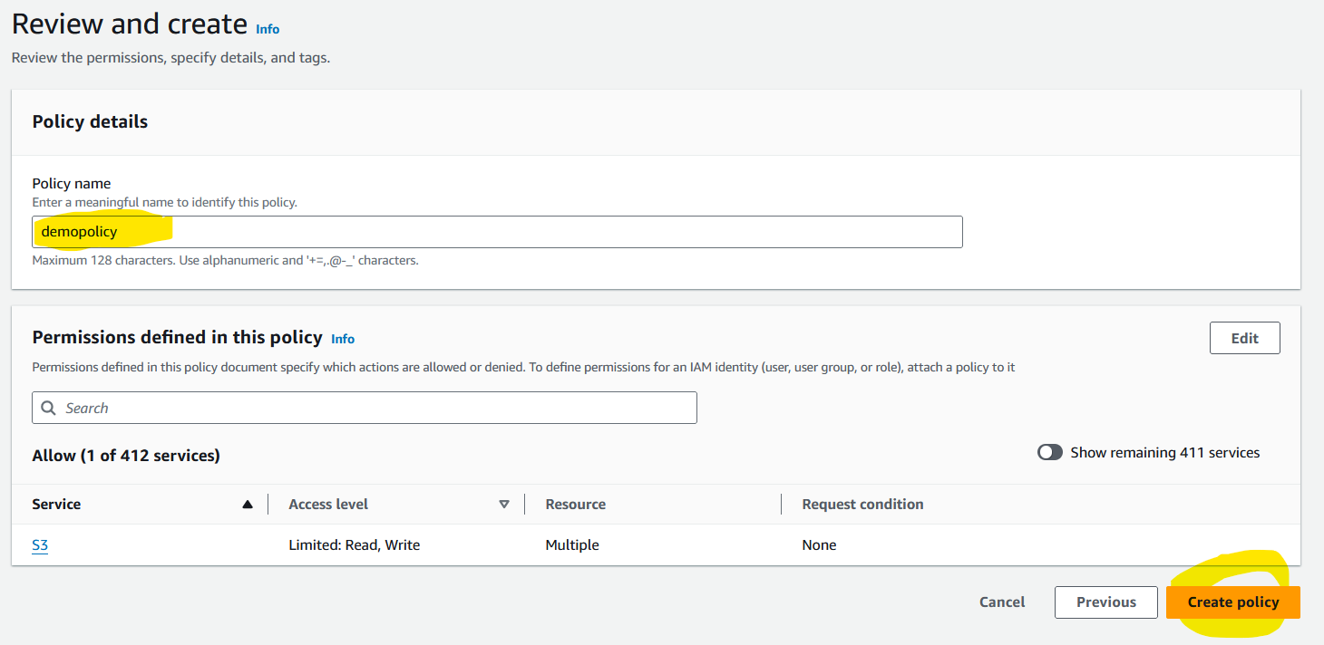
Give appropriate name

Slide 59
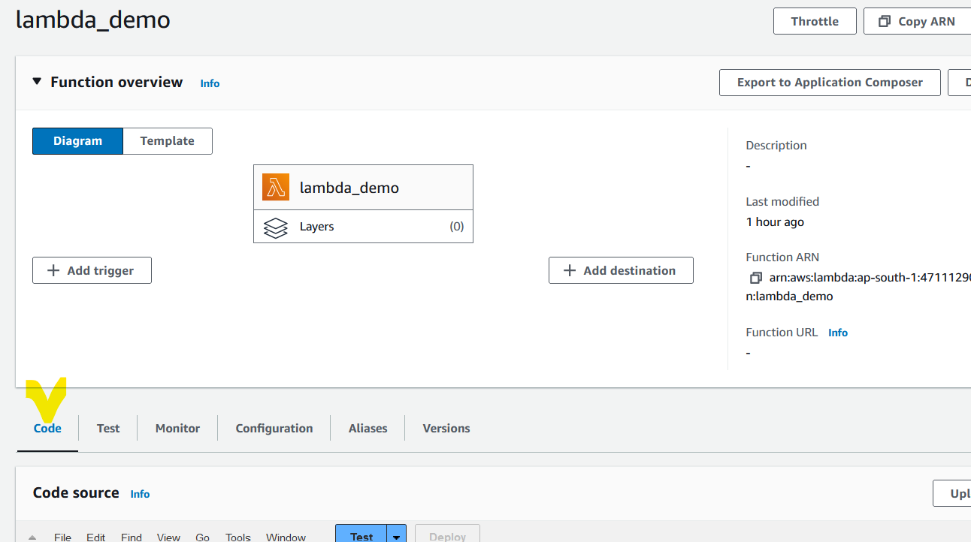
GO back to code

Slide 60
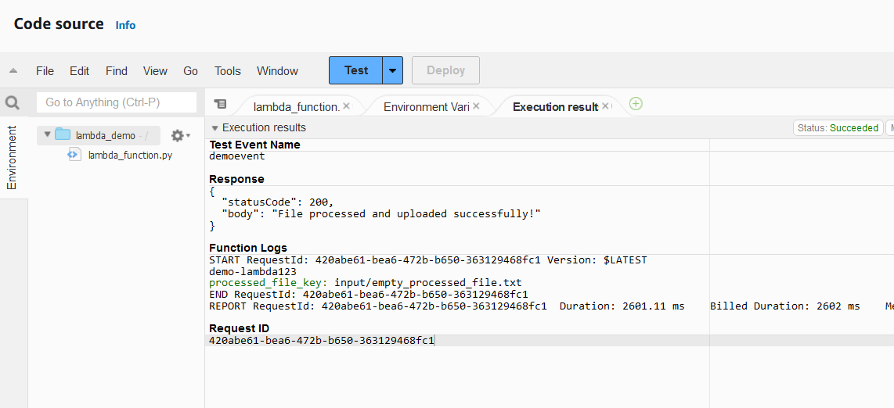
Test code again

Slide 61
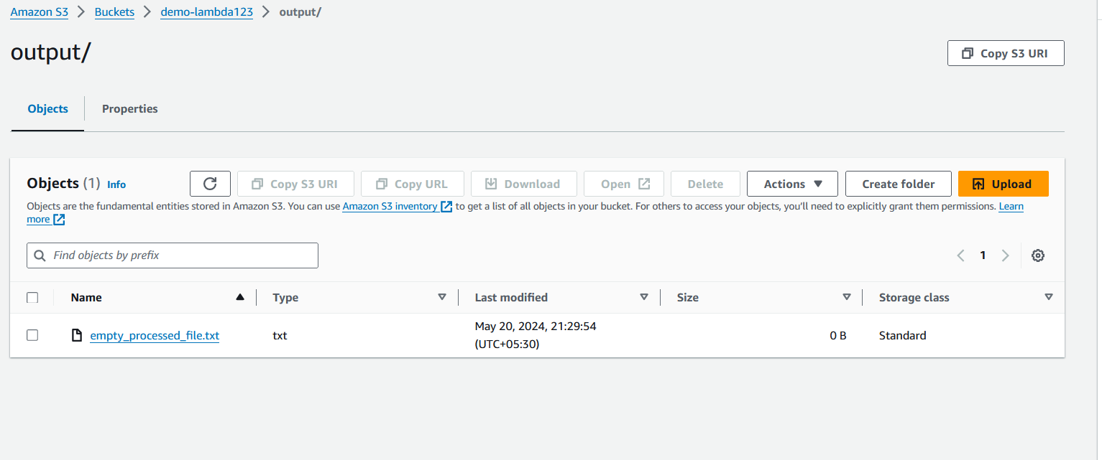
Processed file created in output folder

